Slide 1
Computer Organization and Architecture
Prof. Indranil Sengupta
Dr. Sarani Bhattacharya
Department of Computer Science and Engineering
IIT Kharagpur

Slide 2
Evolution of Computer Systems

Slide 3
Introduction
Computers have become part and parcel of our daily lives.
They are everywhere (embedded systems?)
Laptops, tablets, mobile phones, intelligent appliances.
It is required to understand how a computer works.
What are there inside a computer?
How does it work?
We distinguish between two terms: Computer Architecture and Computer Organization.

Slide 4
Computer Organization:
Design of the components and functional blocks using which computer systems are built.
Analogy: civil engineer’s task during building construction (cement, bricks, iron rods, and other building materials).
Computer Architecture:
How to integrate the components to build a computer system to achieve a desired level of performance.
Analogy: architect’s task during the planning of a building (overall layout, floorplan, etc.).

Slide 5
Historical Perspective
Constant quest of building automatic computing machines have driven the development of computers.
Initial efforts: mechanical devices like pulleys, levers and gears.
During World War II: mechanical relays to carry out computations.
Vacuum tubes developed: first electronic computer called ENIAC.
Semiconductor transistors developed and journey of miniaturization began.
SSI → MSI → LSI → VLSI → ULSI → …. Billions of transistors per chip

Slide 6
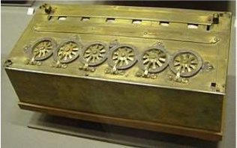
PASCALINE (1642)
Mechanical calculator invented by B. Pascal.
Could add and subtract two numbers directly, and multiply and divide by repetition.

Slide 7
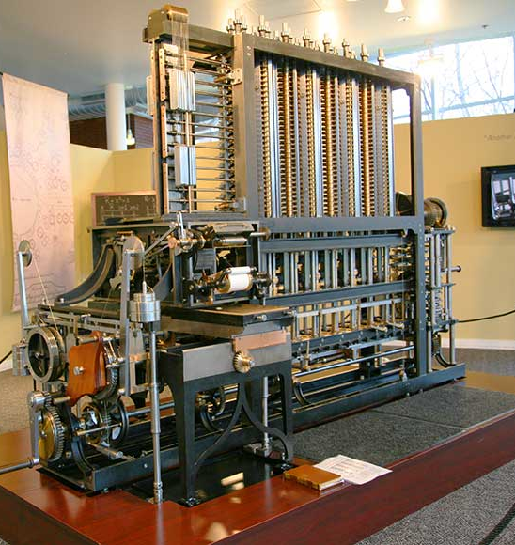
Babbage Engine
First automatic computing engine was designed by Charles Babbage in the 19th century, but he could not build it.
The first complete Babbage engine was built in 2002, 153 years after it was designed.
8000 parts.
Weighed 5 tons.
11 feet in length.

Slide 8
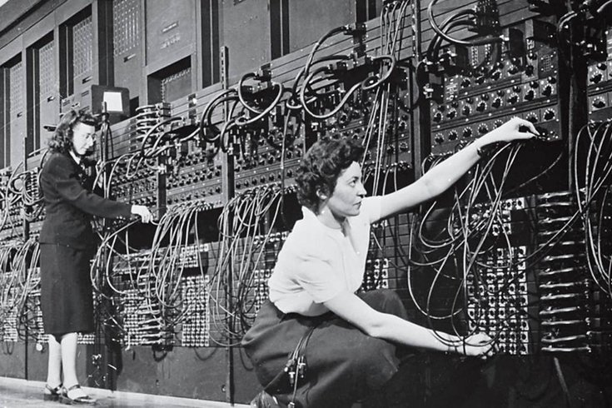
ENIAC (Electrical Numerical Integrator and Calculator)
Developed at the University of Pennsylvania in 1945.
Used 18,000 vacuum tubes, weighed 30 tons, and occupied a 30ft x 50ft space.

Slide 9
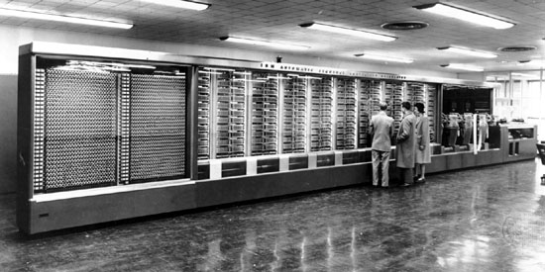
Harvard Mark 1
Built at the University of Harvard in 1944, with support from IBM.
Used mechanical relays (switches) to represent data.
It weighed 35 tons, and required 500 miles of wiring.

Slide 10
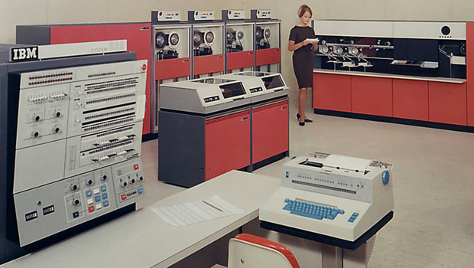
IBM System/360
Very popular mainframe computer of the 60s and 70s.
Introduced many advanced architectural concepts that appeared in microprocessors several decades later.

Slide 11
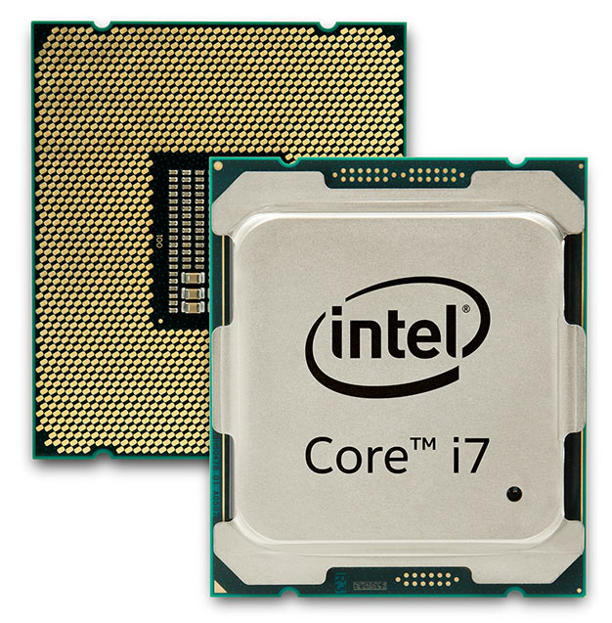
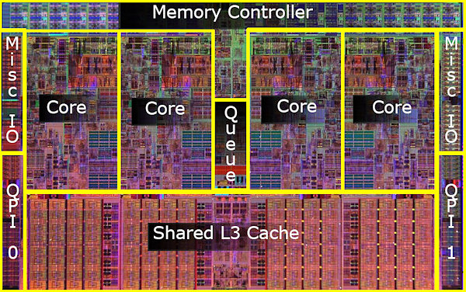
Intel Core i7
A modern processor chip, that comes in dual-core, quad-core and 6-core variants.
64-bit processor that comes with various microarchitectures like Haswell, Nehalem, Sandy Bridge, etc.

Slide 12
Generation | Main Technology | Representative Systems
First (1945-54) | Vacuum tubes, relays | Machine & assembly language ENIAC, IBM-701
Second (1955-64) | Transistors, memories, I/O processors | Batch processing systems, HLL IBM-7090
Third (1965-74) | SSI and MSI integrated circuits Microprogramming | Multiprogramming / Time sharing IBM 360, Intel 8008
Fourth (1975-84) | LSI and VLSI integrated circuits | Multiprocessors Intel 8086, 8088
Fifth (1984-90) | VLSI, multiprocessor on-chip | Parallel computing, Intel 486
Sixth (1990 onwards) | ULSI, scalable architecture, post-CMOS technologies | Massively parallel processors Pentium, SUN Ultra workstations

Slide 13
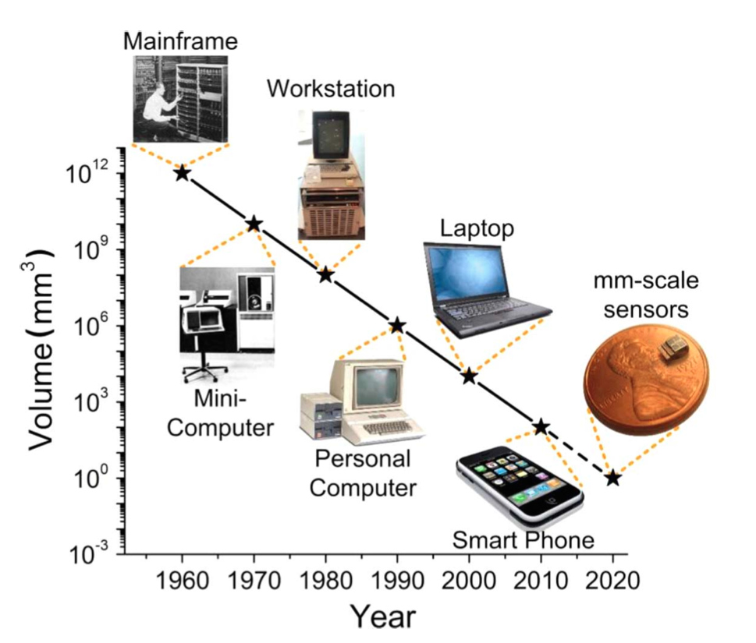
Evolution of the Types of Computer Systems
The future?
Large-scale IoT based systems.
Wearable computing.
Intelligent objects.

Slide 14
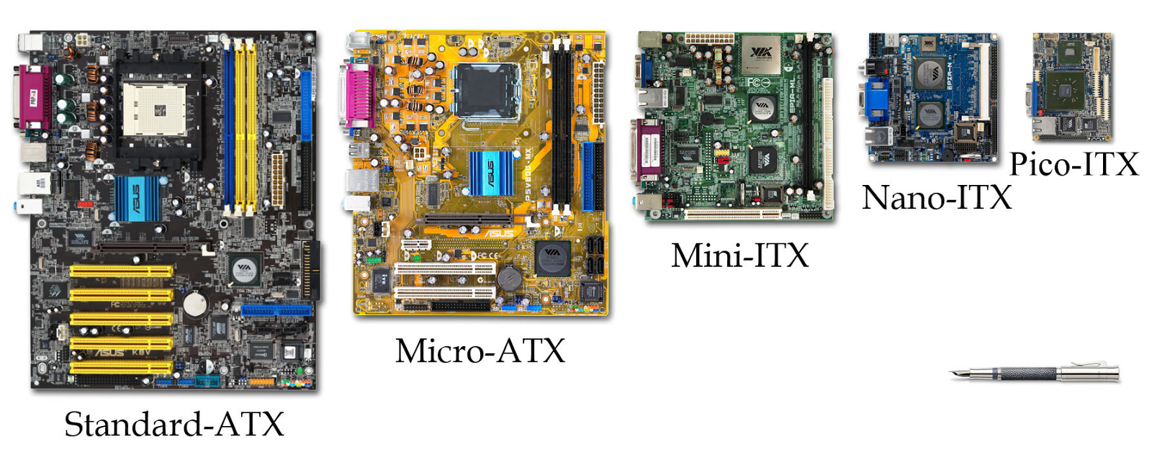
Evolution of PC form factors over the years

Slide 15
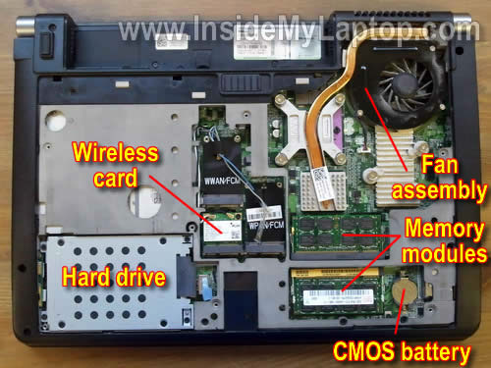
Inside a laptop
Miniaturization in feature sizes of all parts.
Hard drive getting replaced by flash-based memory devices.
Cooling is a major issue.

Slide 16
Moore’s Law
Refers to an observation made by Intel co-founder Gordon Moore in 1965. He noticed that the number of transistors per square inch on integrated circuits had doubled every year since their invention.
Moore's law predicts that this trend will continue into the foreseeable future.
Although the pace has slowed, the number of transistors per square inch has since doubled approximately every 18 months. This is used as the current definition of Moore's law.

Slide 17
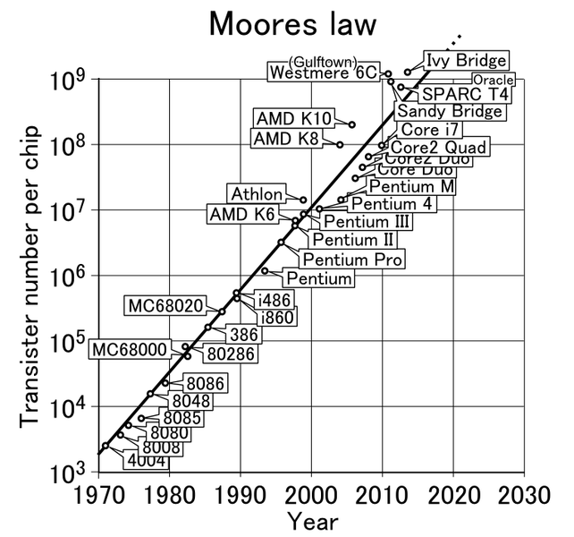

Slide 18
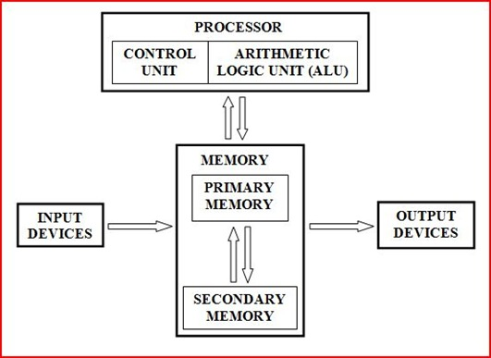
Simplified Block Diagram of a Computer System
All instructions and data are stored in memory.
An instruction and the required data are brought into the processor for execution.
Input and Output devices interface with the outside world.
Referred to as von-Neumann architecture.

Slide 19
Inside the Processor
Also called Central Processing Unit (CPU).
Consists of a Control Unit and an Arithmetic Logic Unit (ALU).
All calculations happen inside the ALU.
The Control Unit generates sequence of control signals to carry out all operations.
The processor fetches an instruction from memory for execution.
An instruction specifies the exact operation to be carried out.
It also specifies the data that are to be operated on.
A program refers to a set of instructions that are required to carry out some specific task (e.g. sorting a set of numbers).

Slide 20
What is the role of ALU?
It contains several registers, some general-purpose and some special-purpose, for temporary storage of data.
It contains circuitry to carry out logic operations, like AND, OR, NOT, shift, compare, etc.
It contains circuitry to carry out arithmetic operations like addition, subtraction, multiplication, division, etc.
During instruction execution, the data (operands) are brought in and stored in some registers, the desired operation carried out, and the result stored back in some register or memory.

Slide 21
What is the role of control unit?
Acts as the nerve center that senses the states of various functional units and sends control signals to control their states.
To carry out a specific operation (say, R1 ← R2 + R3), the control unit must generate control signals in a specific sequence.
Enable the outputs of registers R2 and R3.
Select the addition operation.
Store the output of the adder circuit into register R1.
When an instruction is fetched from memory, the operation (called opcode) is decoded by the control unit, and the control signals issued.

Slide 22
Inside the Memory Unit
Two main types of memory subsystems.
Primary or Main memory, which stores the active instructions and data for the program being executed on the processor.
Secondary memory, which is used as a backup and stores all active and inactive programs and data, typically as files.
The processor only has direct access to the primary memory.
In reality, the memory system is implemented as a hierarchy of several levels.
L1 cache, L2 cache, L3 cache, primary memory, secondary memory.
Objective is to provide faster memory access at affordable cost.

Slide 23
Various different types of memory are possible.
Random Access Memory (RAM), which is used for the cache and primary memory sub-systems. Read and Write access times are independent of the location being accessed.
Read Only Memory (ROM), which is used as part of the primary memory to store some fixed data that cannot be changed.
Magnetic Disk, which uses direction of magnetization of tiny magnetic particles on a metallic surface to store data. Access times vary depending on the location being accessed, and is used as secondary memory.
Flash Memory, which is replacing magnetic disks as secondary memory devices. They are faster, but smaller in size as compared to disk.

Slide 24
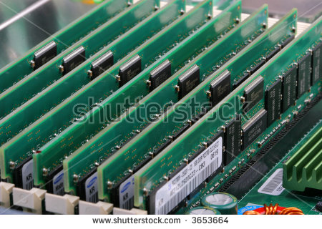
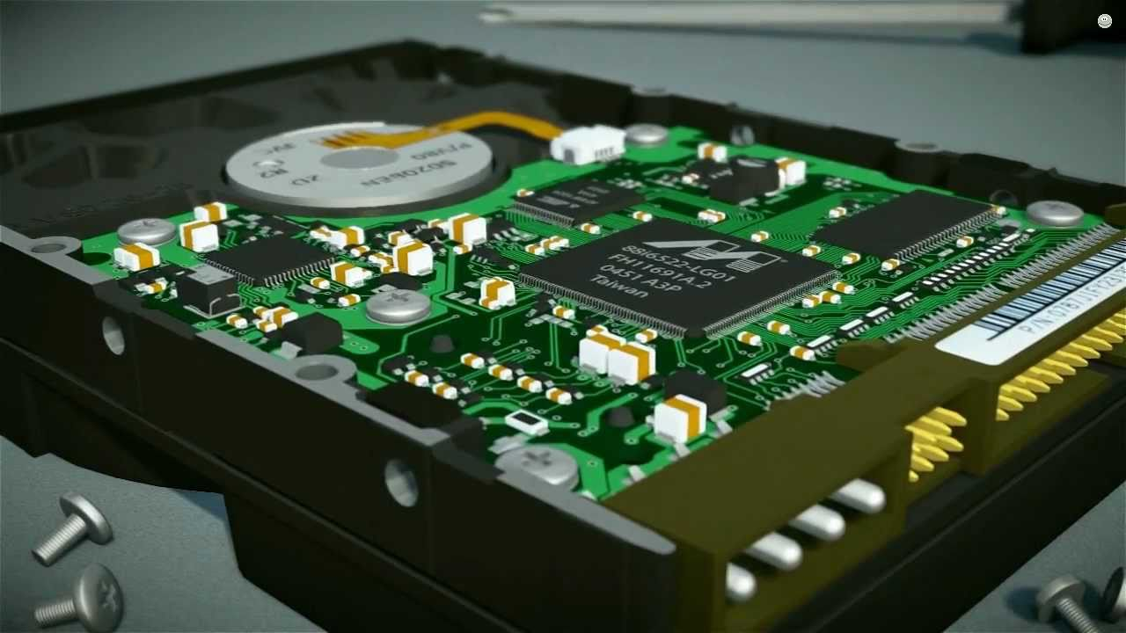
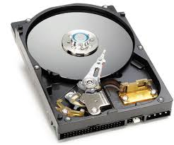
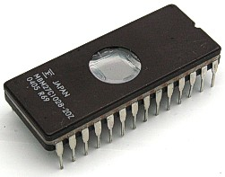

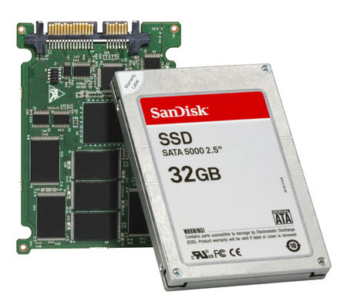
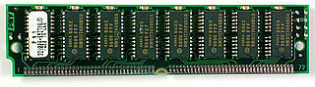

Slide 25
Input Unit
Used to feed data to the computer system from the external environment.
Data are transferred to the processor/memory after appropriate encoding.
Common input devices:
Keyboard
Mouse
Joystick
Camera

Slide 26
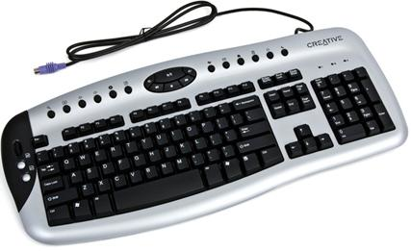
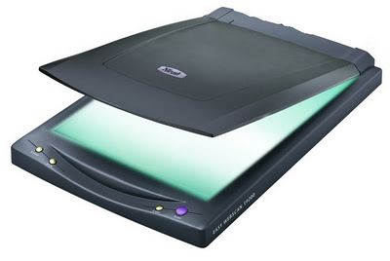
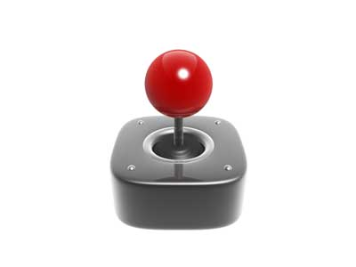
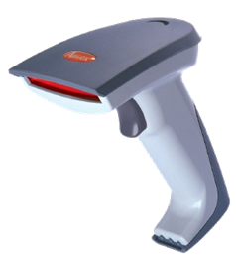
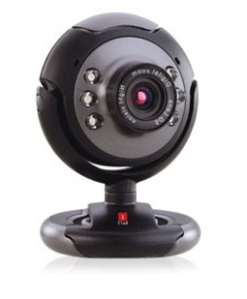
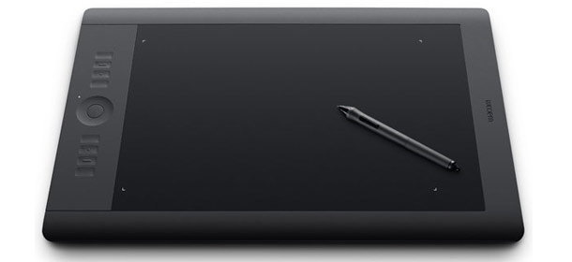


Slide 27
Output Unit
Used to send the result of some computation to the outside world.
Common output devices:
LCD/LED screen
Printer and Plotter
Speaker / Buzzer
Projection system

Slide 28
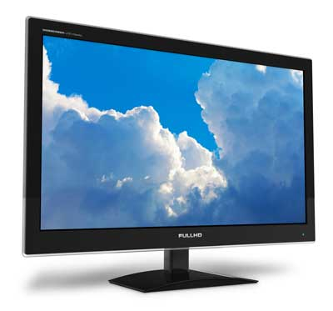
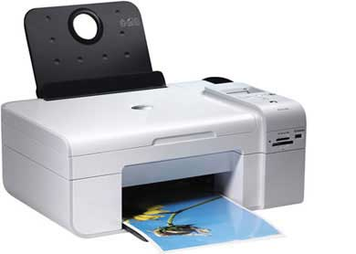
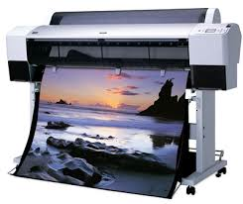
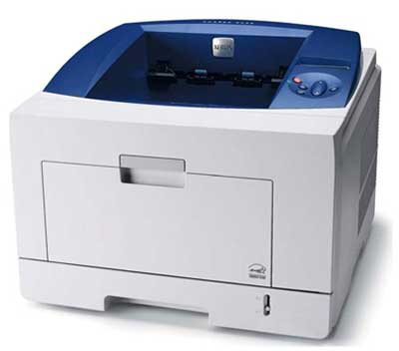
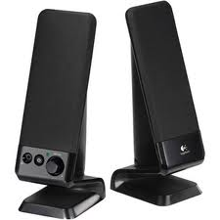
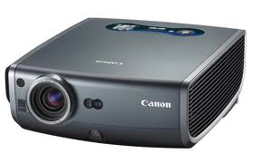

Slide 29
Basic Operation of a Computer

Slide 30
Introduction
The basic mechanism through which an instruction gets executed shall be illustrated.
May be recalled:
ALU contains a set of registers, some general-purpose and some special-purpose.
First we briefly explain the functions of the special-purpose registers before we look into some examples.

Slide 31
For Interfacing with the Primary Memory
Address
Two special-purpose registers are used:
Memory Address Register (MAR): Holds the address of the memory location to be accessed.
Memory Data Register (MDR): Holds the data that is being written into memory, or will receive the data being read out from memory.
Memory considered as a linear array of storage locations (bytes or words) each with unique address.
0
1
2
3
4
5
1023
Memory

Slide 32
PROCESSOR
MA R
Address
PRIMARY
MEMORY
MD R
Data
Control Signals

Slide 33
To read data from memory
Load the memory address into MAR.
Issue the control signal READ.
The data read from the memory is stored into MDR.
To write data into memory
Load the memory address into MAR.
Load the data to be written into MDR.
Issue the control signal WRITE.

Slide 34
For Keeping Track of Program / Instructions
Two special-purpose registers are used:
Program Counter (PC): Holds the memory address of the next instruction to be executed.
Automatically incremented to point to the next instruction when an instruction is being executed.
Instruction Register (IR): Temporarily holds an instruction that has been fetched from memory.
Need to be decoded to find out the instruction type.
Also contains information about the location of the data.

Slide 35
Architecture of the Example Processor
Memory
MAR
MDR
Control
R₀
PC
R₁
Processor
.
.
ALU
IR
R_{n-1}
n General Purpose Registers (GPR)

Slide 36
Example Instructions
We shall illustrate the process of instruction execution with the help of the following two instructions:
ADD R1, LOCA
Add the contents of memory location LOCA (i.e. address of the memory location is LOCA) to the contents of register R1.
R1 ← R1 + Mem[LOCA]
ADD R1, R2
Add the contents of register R2 to the contents of register R1.
R1 ← R1 + R2

Slide 37
Execution of ADD R1,LOCA
Assume that the instruction is stored in memory location 1000, the initial value of R1 is 50, and LOCA is 5000.
Before the instruction is executed, PC contains 1000.
Content of PC is transferred to MAR. MAR ← PC
READ request is issued to memory unit.
The instruction is fetched to MDR. MDR ← Mem[MAR]
Content of MDR is transferred to IR. IR ← MDR
PC is incremented to point to the next instruction. PC ← PC + 4
The instruction is decoded by the control unit.
ADD R1
5000

Slide 38
LOCA (i.e. 5000) is transferred (from IR) to MAR. MAR ← IR[Operand]
READ request is issued to memory unit.
The data is fetched to MDR. MDR ← Mem[MAR]
The content of MDR is added to R1. R1 ← R1 + MDR
The steps being carried out are called micro-operations:
MAR ← PC
MDR ← Mem[MAR]
IR ← MDR
PC ← PC + 4
MAR ← IR[Operand]
MDR ← Mem[MAR]
R1 ← R1 + MDR

Slide 39
R1
50
125
PC = 1000
MAR = 1000
PC = PC + 4 = 1004
MDR = ADD R1, LOCA
IR = ADD R1, LOCA
MAR = LOCA = 5000
MDR = 75
R1 = R1 + MDR = 50 + 75 = 125
Address | Content
1000 | ADD R1, LOCA
1004 | …
5000
75
LOCA

Slide 40
Execution of ADD R1,R2
Assume that the instruction is stored in memory location 1500, the initial value of R1 is 50, and R2 is 200.
Before the instruction is executed, PC contains 1500.
Content of PC is transferred to MAR. MAR ← PC
READ request is issued to memory unit.
The instruction is fetched to MDR. MDR ← Mem[MAR]
Content of MDR is transferred to IR. IR ← MDR
PC is incremented to point to the next instruction. PC ← PC + 4
The instruction is decoded by the control unit.
R2 is added to R1. R1 ← R1 + R2
ADD R1, R2

Slide 41
R1
50
250
R2
200
PC = 1500
MAR = 1500
PC = PC + 4 = 1504
MDR = ADD R1, R2
IR = ADD R1, R2
R1 = R1 + R2 = 250
Address | Instruction
1500 | ADD R1, R2
1504 | …

Slide 42
Bus Architecture
The different functional modules must be connected in an organized manner to form an operational system.
Bus refers to a group of lines that serves as a connecting path for several devices.
The simplest way to connect the functional unit is to use the single bus architecture.
Only one data transfer allowed in one clock cycle.
For multi-bus architecture, parallelism in data transfer is allowed.

Slide 43
System-Level Single Bus Architecture
Input
Output
Memory
Processor

Slide 44
System-Level Two-Bus Architecture
Processor
Memory
Output
Device
Input Device
I/O Processor

Slide 45
Single-Bus Architecture Inside the Processor
There is a single bus inside the processor.
ALU and the registers are all connected via the single bus.
This bus is internal to the processor and should not be confused with the external bus that connects the processor to the memory and I/O devices.
A typical single-bus processor architecture is shown on the next slide.
Two temporary registers Y and Z are also included.
Register Y temporarily holds one of the operands of the ALU.
Register Z temporarily holds the result of the ALU operation.
The multiplexer selects a constant operand 4 during execution of the micro-operation: PC ← PC + 4.

Slide 46
Internal Processor Bus
PC
Instruction Decoding and Control Unit
Control signals
.
.
.
MEMORY
MAR
MDR
IR
4
Y
R0
Select
MUX
R1
.
.
.
Function select
ALU
Carry-in
R_{n-1}
Z

Slide 47
Multi-Bus Architectures
Modern processors have multiple buses that connect the registers and other functional units.
Allows multiple data transfer micro-operations to be executed in the same clock cycle.
Results in overall faster instruction execution.
Also advantageous to have multiple shorter buses rather than a single long bus.
Smaller parasitic capacitance, and hence smaller delay.

Slide 48
Memory Addressing and Languages

Slide 49
Overview of Memory Organization
Memory is one of the most important sub-systems of a computer that determines the overall performance.
Conceptual view of memory:
Array of storage locations, with each storage location having a unique address.
Each storage location can hold a fixed amount of information (multiple of bits, which is the basic unit of data storage).
A memory system with M locations and N bits per location, is referred to as an M x N memory.
Both M and N are typically some powers of 2.
Example: 1024 x 8, 65536 x 32, etc.

Slide 50
Some Terminologies
Bit: A single binary digit (0 or 1).
Nibble: Collection of 4 bits.
Byte: Collection of 8 bits.
Word: Does not have a unique definition.
Varies from one computer to another; typically 32 or 64 bits.

Slide 51
How is Memory Organized?
Memory is byte or word organized.
Every byte or w of the memory has a unique address.
Multiple bytes of data can be accessed by an instruction.
Example: Half-word (2 bytes), Word (4 bytes), Long Word (8 bytes).
For higher data transfer rate, memory is often organized such that multiple bytes can be read or written simultaneously.
Necessary to bridge the processor-memory speed gap.
Shall be discussed later in detail.

Slide 52
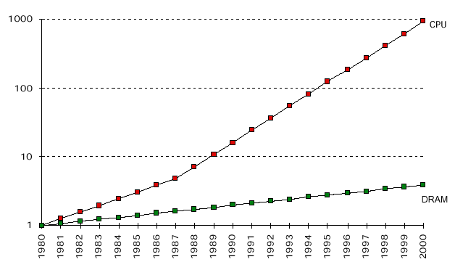
Processor-Memory Performance Gap
With technological advancements, both processor and memory are becoming faster.
However, the speed gap is steadily increasing.
Special techniques are needed to bridge this gap.
Cache memory
Memory interleaving

Slide 53
How do we Specify Memory Sizes?
Unit | Bytes | In Decimal
8 bits (B) | 1 or 2⁰ | 10⁰
Kilobyte (KB) | 1024 or 2¹⁰ | 10³
Megabyte (MB) | 1,048,576 or 2²⁰ | 10⁶
Gigabyte (GB) | 1,073,741,824 or 2³⁰ | 10⁹
Terabyte (TB) | 1,099,511,627,776 or 2⁴⁰ | 10¹²
Petabyte (PB) | 2⁵⁰ | 10¹⁵
Exabyte (EB) | 2⁶⁰ | 10¹⁸
Zettabyte (ZB) | 2⁷⁰ | 10²¹

Slide 54
If there are n bits in the address, the maximum number of storage locations can be 2^{n}.
For n=8, 256 locations.
For n=16, 64K locations.
For n=20, 1M locations.
For n=32, 4G locations.
Modern-day memory chips can store several Gigabits of data.
Dynamic RAM (DRAM).
MEMORY
Address (n bits)
Data (m bits)
RD
WR
EN

Slide 55
Address | Contents
0000 0000 | 0000 0000 0000 0001
0000 0001 | 0000 0100 0101 0000
0000 0010 | 1010 1000 0000 0000
:
:
1111 1111 | 1011 0000 0000 1010
An example: 2⁸ x 16 memory

Slide 56
Some Examples
A computer has 64 MB (megabytes) of byte-addressable memory. How many bits are needed in the memory address?
Address Space = 64 MB = 2⁶ X 2²⁰ B = 2²⁶ B
If the memory is byte addressable, we need 26 bits of address.
A computer has 1 GB of memory. Each word in this computer is 32 bits. How many bits are needed to address any single word in memory?
Address Space = 1 GB = 2³⁰ B
1 word = 32 bits = 4 B
We have 2³⁰ / 4 = 2²⁸ words
Thus, we require 28 bits to address each word.

Slide 57
Byte Ordering Conventions
Many data items require multiple bytes for storage.
Different computers use different data ordering conventions.
Low-order byte first
High-order byte first
Thus a 16-bit number 11001100 00101010 can be stored as either:
Data Type | Size (in Bytes)
Character | 1
Integer | 4
Long integer | 8
Floating-point | 4
Double-precision | 8
Typical data sizes
11001100
00101010
or
00101010
11001100

Slide 58
The two conventions have been named as:
Little Endian
The least significant byte is stored at lower address followed by the most significant byte. Examples: Intel processors, DEC alpha, etc.
Same concept followed for arbitrary multi-byte data.
Big Endian
The most significant byte is stored at lower address followed by the least significant byte. Examples: IBM’s 370 mainframes, Motorola microprocessors, TCP/IP, etc.
Same concept followed for arbitrary multi-byte data.

Slide 59
An Example
Represent the following 32-bit number in both Little-Endian and Big-Endian in memory from address 2000 onwards:
01010101 00110011 00001111 11000011
Little Endian
Address | Data
2000 | 11000011
2001 | 00001111
2002 | 00110011
2003 | 01010101
Big Endian
Address | Data
2000 | 01010101
2001 | 00110011
2002 | 00001111
2003 | 11000011

Slide 60
Memory Access by Instructions
The program instructions and data are stored in memory.
In von-Neumann architecture, they are stored in the same memory.
In Harvard architecture, they are stored in different memories.
For executing the program, two basic operations are required.
Load: The contents of a specified memory location is read into a processor register. LOAD R1, 2000
Store: The contents of a processor register is written into a specified memory location. STORE 2020, R3

Slide 61
An Example
Compute S = (A + B) – (C – D)
LOAD R1,A
LOAD R2,B
ADD R3,R1,R2 // R3 = A + B
LOAD R1,C
LOAD R2,D
SUB R4,R1,R2 // R4 = C – D
SUB R3,R3,R4 // R3 = R3 – R4
STORE S,R3

Slide 62
Machine, Assembly and High Level Language
Machine Language
Native to a processor: executed directly by hardware.
Instructions consist of binary code: 1’s and 0’s.
Assembly Language
Low-level symbolic version of machine language.
One to one correspondence with machine language.
Pseudo instructions are used that are much more readable and easy to use.
High-Level Language
Programming languages like C, C++, Java.
More readable and closer to human languages.

Slide 63
Assemblers and Compilers
Assembler
Translates an assembly language program to machine language.
Compiler
Translate a high-level language programs to assembly/machine language.
The translation is done by the compiler directly, or
The compiler first translates to assembly language and then the assembler converts it to machine code.

Slide 64
Compiler and Assembler
High-level language
Compiler
Compiler
Assembly
language
Alternative 2
Assembler
Machine code

Slide 65
The compiler or assembler may run on the native machine for which the target code is being generated, or can be run on another machine.
Called cross-assembler or cross-compiler.
Example 1: An 8085 cross-assembler is running on a desktop PC which generates 8085 machine code.
Example 2: An ARM embed-C cross compiler is running on desktop PC which generates ARM machine code for an embedded development board.

Slide 66
Software and Architecture Types

Slide 67
Introduction
A software or a program consists of a set of instructions required to solve a specific problem.
A program to sort a set of numbers.
A program to find the roots of a quadratic equation.
A program to find the inverse of a matrix.
The C compiler that translates a C program to machine language.
The editor program that helps us in creating a document.
The operating system that helps us in using the computer system.

Slide 68
Types of Programs
Broadly we can classify programs/software into two types:
Application Software
Which helps the user to solve a particular user-level problem.
May need system software for execution.
System Software
A collection of programs that helps the users to create, analyze and run their programs.

Slide 69
(a) Application Software
Application software helps users solve particular problems.
In most cases, application software resides on the computer’s hard disk or removable storage media (DVD, USB drive, etc.).
Typical examples:
Financial accounting package
Mathematical packages like MATLAB or MATHEMATICA
An app to book a cab
An app to monitor the health of a person

Slide 70
(b) System Software
System software is a collection of programs, which helps users run other programs.
Typical operations carried out by system software:
Handling user requests
Managing application programs and storing them as files
File management in secondary storage devices
Running standard applications such as word processor, internet browser, etc.
Managing I/O units
Program translation from source form to object form
Linking and running user programs

Slide 71
Some very commonly used system software:
Operating system (WINDOWS, LINUX, MAC/OS, ANDROID, etc.)
Instance of a program that never terminates.
The program continues running until either the machine is switched off or the user manually shuts down the machine.
Compilers and assemblers
Linkers and loaders
Editors and debuggers

Slide 72
Operating System
Users & Application Software
Provides an interface between computer hardware and users.
Two layers:
Kernel: contains low-level routines for resource management.
Shell: provides an interface for the users to interact with the computer hardware through the kernel.
Shell
Kernel
Computer Hardware

Slide 73
The OS is a collection of routines that is used to control sharing of various computer resources as they execute application programs.
Typical resources: Processor, Memory, Files, I/O devices, etc.
These tasks include:
Assigning memory and disk space to program and data files.
Moving data between I/O devices, memory and disk units.
Handling I/O operations, with parallel operations where possible.
Handling multiple user programs that are running at the same time.

Slide 74
Depending on the intended use of the computer system, the goal of the OS may differ.
Classical multi-programming systems
Several user programs loaded in memory.
Switch to another program when one program gets blocked due to I/O.
Objective is to maximize resource utilization.
Modern time-sharing systems
Widely used because every user can now afford to have a separate terminal.
Processor time shared among a number of interactive users.
Objective is to reduce the user response time.

Slide 75
Real-time systems
Several applications are running with specific deadlines.
Deadlines can be either hard or soft.
Interrupt-driven operation – processor interrupted when a task arrives.
Examples: missile control system, industrial manufacturing plant, patient health monitoring and control system, automotive control system, etc.
Mobile (phone) systems
Here user responsiveness is the most important.
Sometimes a program that makes the system slow or hogs too much memory may be forcibly stopped.

Slide 76
Classification of Computer Architecture
Broadly can be classified into two types:
Von-Neumann architecture
Harvard architecture
How is a computer different from a calculator?
They have similar circuitry inside (e.g. for doing arithmetic).
In a calculator, user has to interactively give the sequence of commands.
In contrast, a computer works using the stored-program concept.
Write a program, store it in memory, and run it in one go.

Slide 77
von-Neumann Architecture
Instructions and data are stored in the same memory module.
More flexible and easier to implement.
Suitable for most of the general purpose processors.
General disadvantage:
The processor-memory bus acts as the bottleneck.
All instructions and data are moved back and forth through the pipe.
Processor
Program / Data
Memory

Slide 78
Harvard Architecture
Separate memory for program and data.
Instructions are stored in program memory and data are stored in data memory.
Instruction and data accesses can be done in parallel.
Some microcontrollers and pipelines with separate instruction and data caches follow this concept.
The processor-memory bottleneck remains.
Processor
Program
Memory
Data Memory

Slide 79
Emerging Architectures
Several architectural concepts have been proposed that deviate significantly from the von-Neumann or Harvard model.
There is a projection for in-memory computing architecture, where storage and computation can be done in the same functional unit.
Memristors are projected to make this possible in the near future.
Memristors can be used in high capacity non-volatile resistive memory systems.
Memristors within the memory can also be controlled to carry out some computations.

Slide 80
Pipeline in Executing Instructions
Instruction execution is typically divided into 5 stages:
Instruction Fetch (IF)
Instruction Decode (ID)
ALU operation (EX)
Memory Access (MEM)
Write Back result to register file (WB)
These five stage can be executed in an overlapped fashion in a pipeline architecture.
Results in significant speedup by overlapping instruction execution.

Slide 81
Basic 5-stage Pipelining Diagram
Instruction | Pipeline Stage
1 | IF | ID | EX | MEM | WB
2 |  | IF | ID | EX | MEM | WB
3 |  |  | IF | ID | EX | MEM | WB
4 |  |  |  | IF | ID | EX | MEM
5 |  |  |  |  | IF | ID | EX
Clock Cycle | 1 | 2 | 3 | 4 | 5 | 6 | 7

Slide 82
How can Harvard Architecture Help?
In clock cycle 4, instruction 4 is trying to fetch an instruction (IF), while instruction 1 may be trying to access data (MEM).
In von-Neumann architecture, one of these two operations will have to wait resulting in pipeline slowdown.
In Harvard architecture, the operations can go on without any speed penalty as the instruction and data memories are separate.

